Slide 1
Error Propagation and Handling

Slide 2
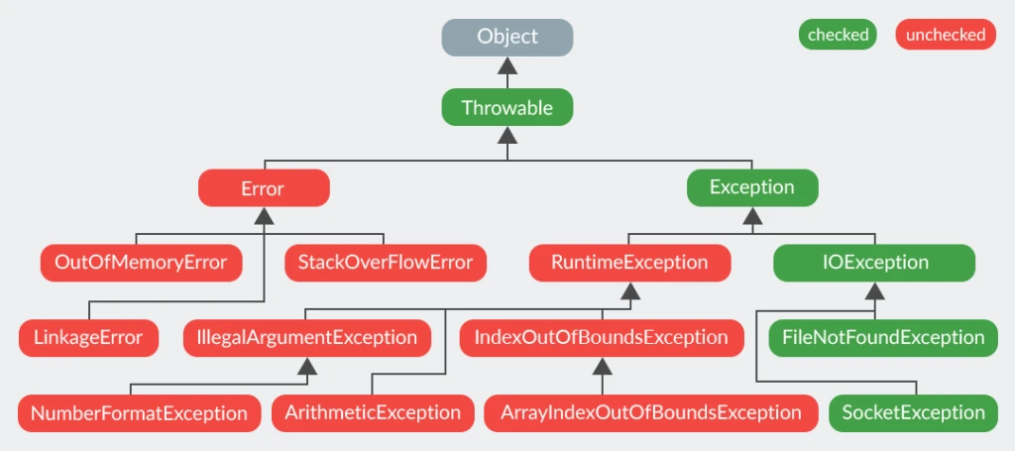
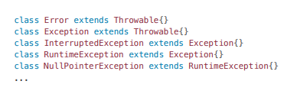
Exceptions Hierarchy and Types

Slide 3
Custom Exception
public class CustomException extends Exception {
public CustomException(String message) {
super(message);
}
public CustomException(String message, Throwable cause) {
super(message, cause);
}
}

Slide 4
Throw vs throws
The throw keyword is used to create a new Exception instance and the throws keyword is used to declare what kind of exceptions can be expected when executing a method.
public File openFile(String path) throws IOException {
File file = new File(path);
if (!file.exists()) {
throw new IOException("File doesn't exist");
}
return file;
}

Slide 5
Exception handling: Catch
public LocalDate parse(String date) {
DateParser parser = new DateParser("yyyy-MM-dd");
try {
return parser.parse(date);
} catch (DateParseException e) {
logger.error("Date parse failed", e);
return null;
}
}

Slide 6
Exception handling: Declare
public LocalDate parse(String date) throws DateParseException {
DateParser parser = new DateParser("yyyy-MM-dd");
return parser.parse(date);
}
Avoid using throws for Unchecked Exceptions

Slide 7
Exception handling: Unreachable
// Compile-time error
try {
System.out.println("Hello world!");
} catch (ParseException e) {
throw new RuntimeException("Runtime Exception");
}

Slide 8
Exception handling: Blocks order
public void parse() {
String date = "2022-12-100";
try {
LocalDate.parse(date, DateTimeFormatter.ISO_DATE);
} catch (DateTimeParseException e) {
throw new DateTimeParseException("DateTimeParseException", date, 1);
} catch (DateTimeException e) {
throw new DateTimeException("DateTimeException");
}
}

Slide 9
Exception handling: Multi-catch
public void parse() {
try {
Path path = Paths.get("path-to-file");
Files.readAllLines(path);
LocalDate.parse("2022-12-10");
} catch (DateTimeParseException | IOException e) {
throw new RuntimeException(e);
}
}

Slide 10
Exception handling: Finally
The finally block is the last section in your try-catch-finally expression and will always get executed–either after the try or after the catch.
public void example() {
FileReader reader = null;
try {
// do something
} catch (FileNotFoundException ex) {
// do something
} finally {
}
}

Slide 11
Q&A

Slide 12
try-with-resources

Slide 13
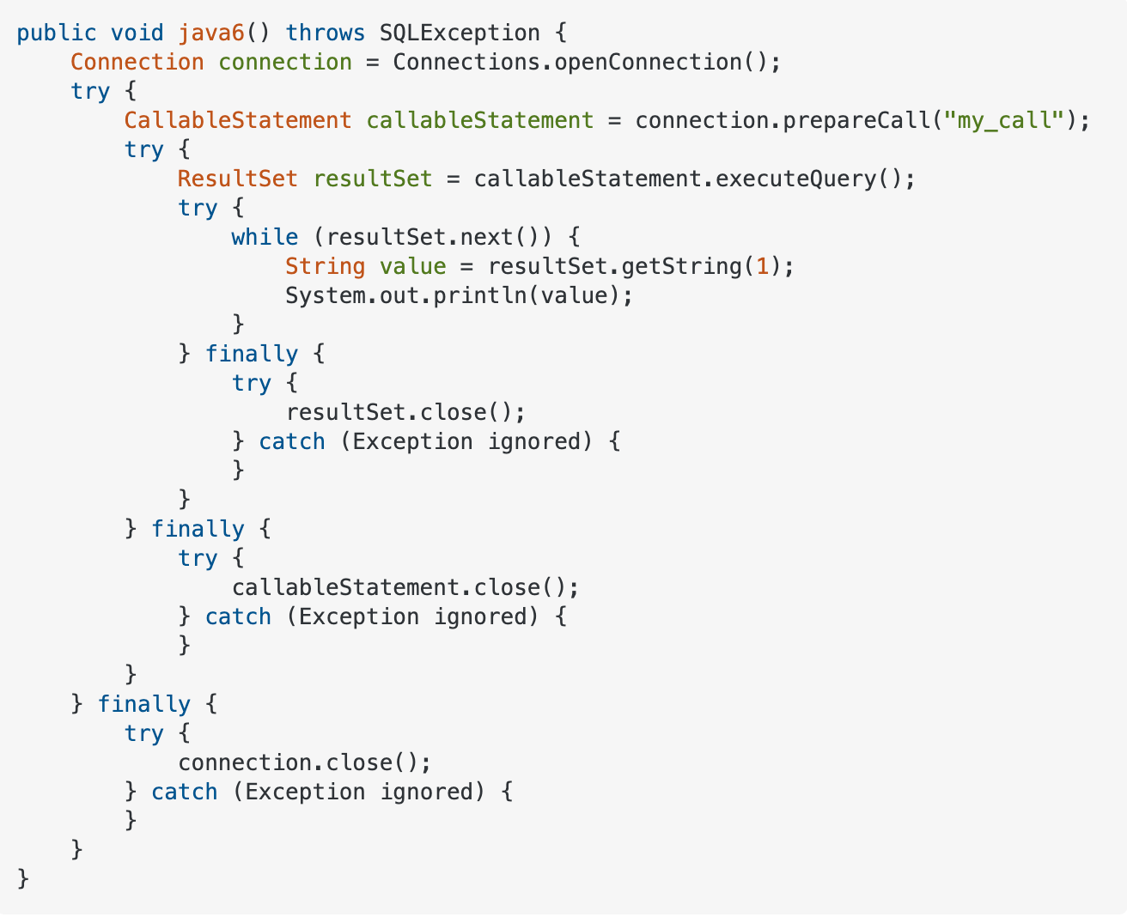
Try-with-resources

Slide 14
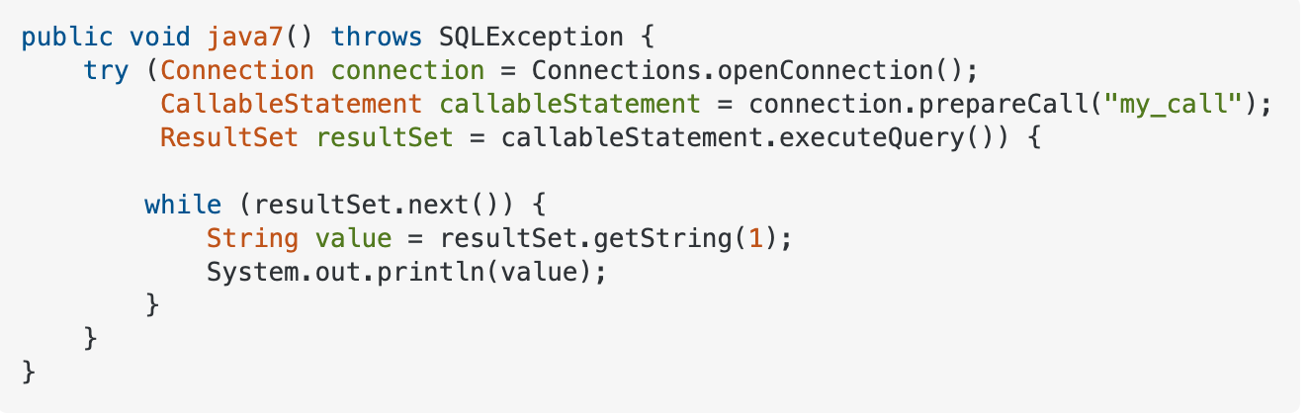
Try-with-resources

Slide 15
Try-with-resources
public String readFirstLineFromFile(String path)throws IOException {
try (FileReader f = new FileReader("a.txt");
BufferedReader br = new BufferedReader(f)) {
return br.readLine();
}
}

Slide 16
Q&A

Slide 17
IO and File API

Slide 18
Java I/O (Input and Output) is used to process the input and produce the output.
In Java, 3 streams are created for us automatically. All these streams are attached with the console.
1) System.out: standard output stream
2) System.in: standard input stream
3) System.err: standard error stream

Slide 19
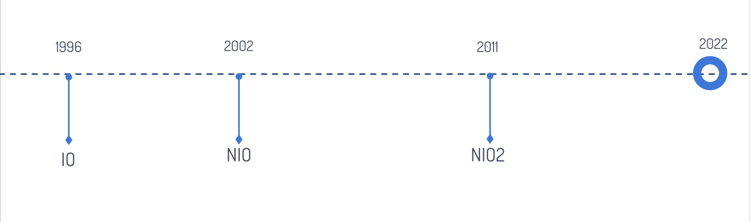
IO Evolution

Slide 20
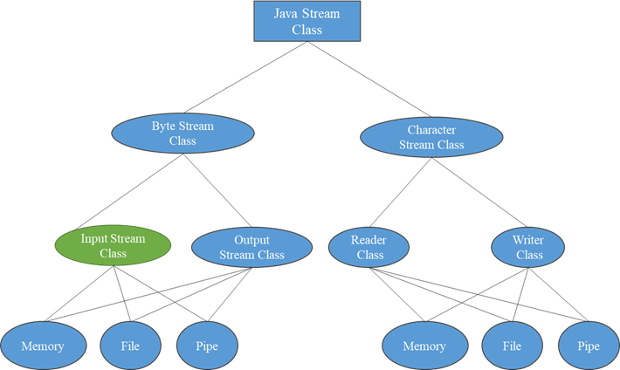
Stream types

Slide 21
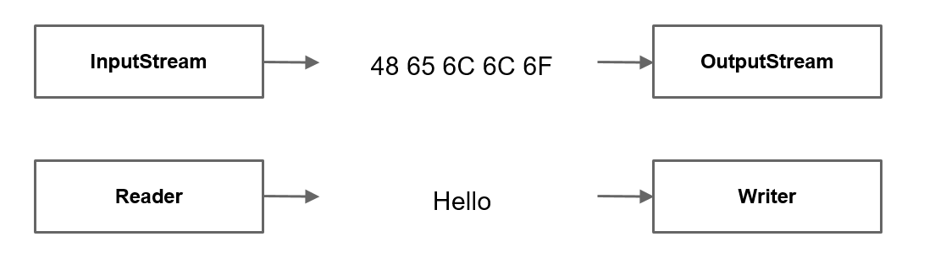
Stream types

Slide 22
OutputStream vs InputStream

Slide 23
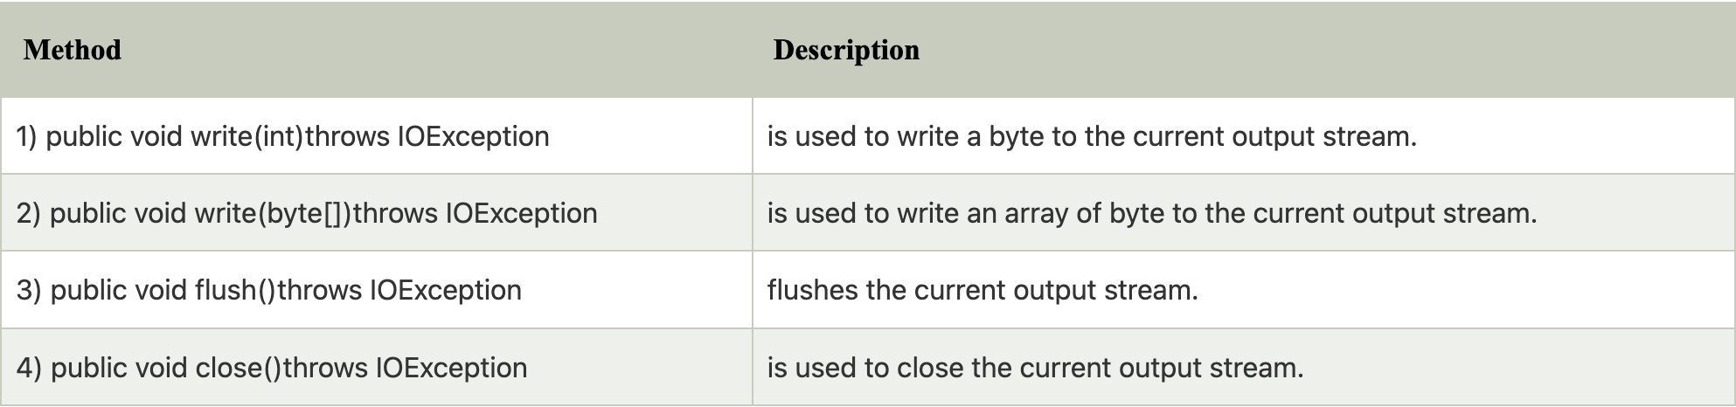
OutputStream class
OutputStream class is an abstract class. It is the superclass of all classes representing an output stream of bytes. An output stream accepts output bytes and sends them to some sink.
Useful methods of OutputStream

Slide 24
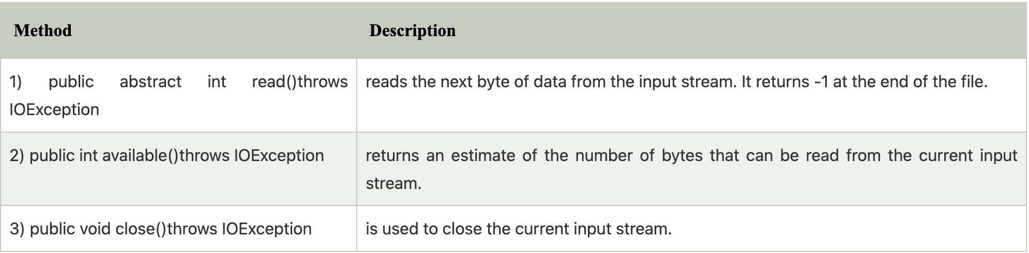
InputStream class
InputStream class is an abstract class. It is the superclass of all classes representing an input stream of bytes.
Useful methods of InputStream

Slide 25
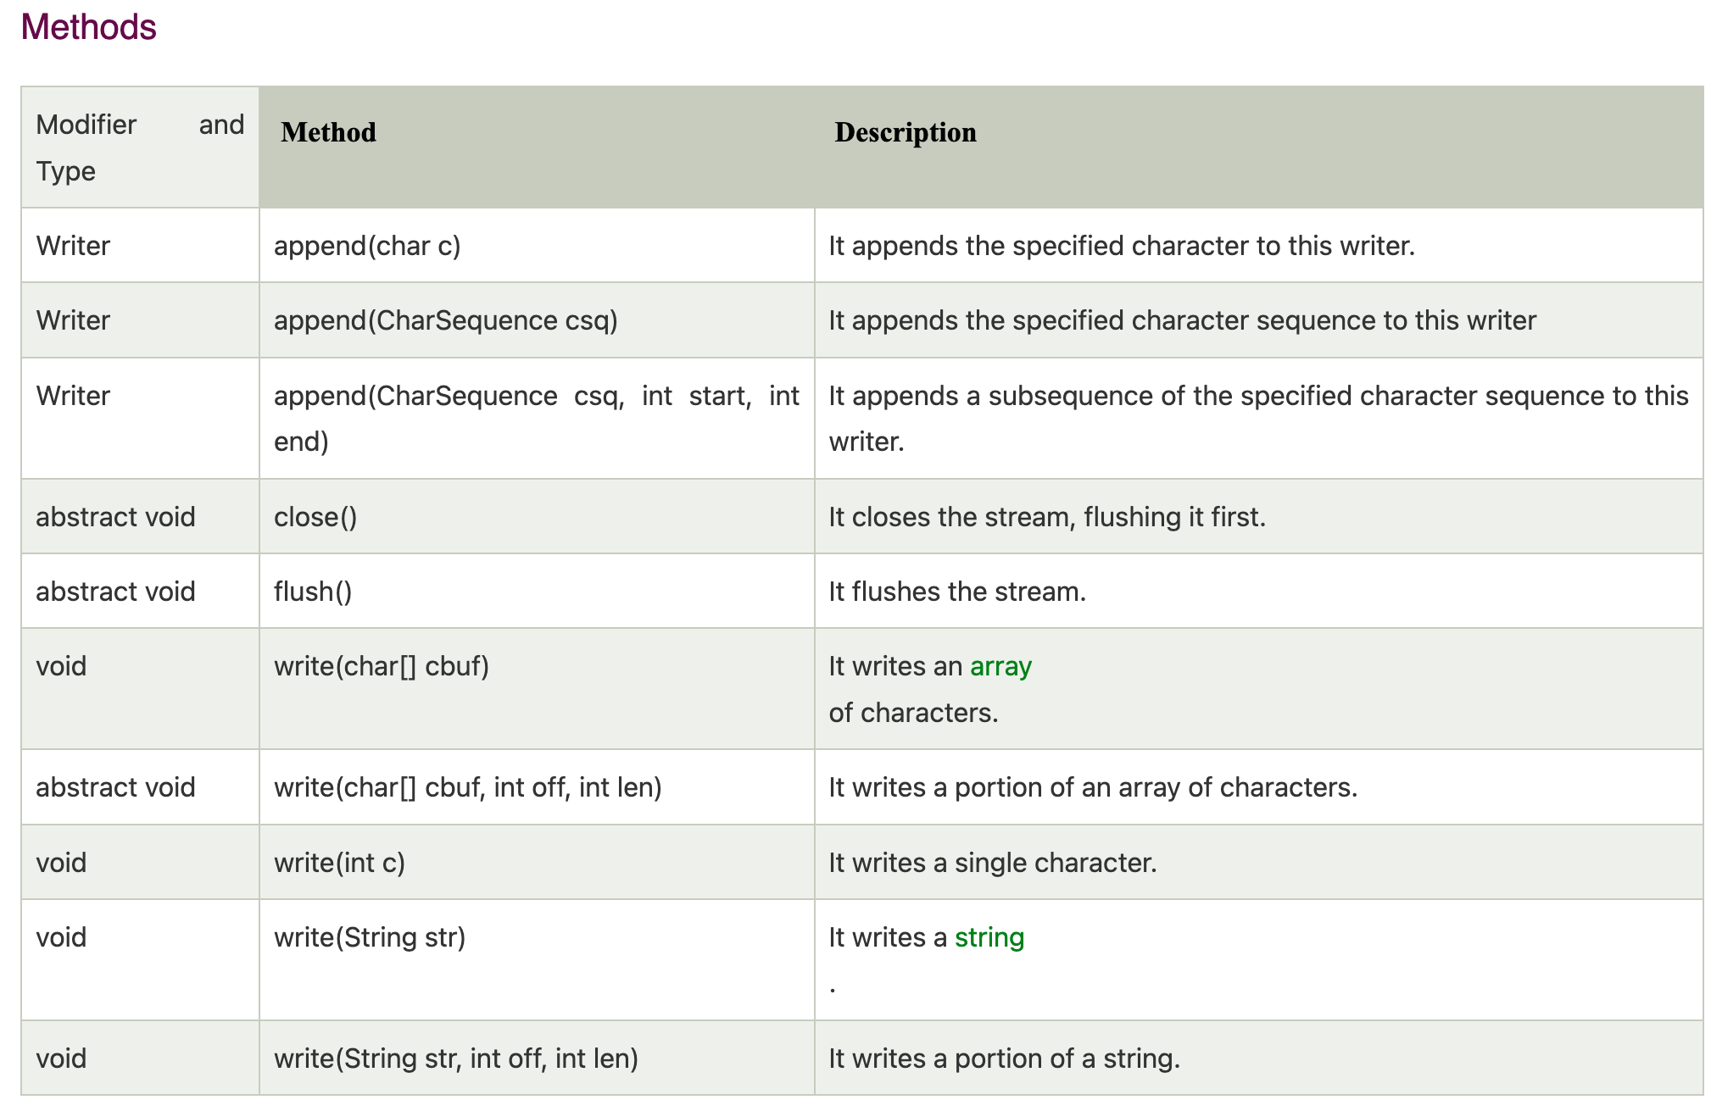
Java Writer

Slide 26
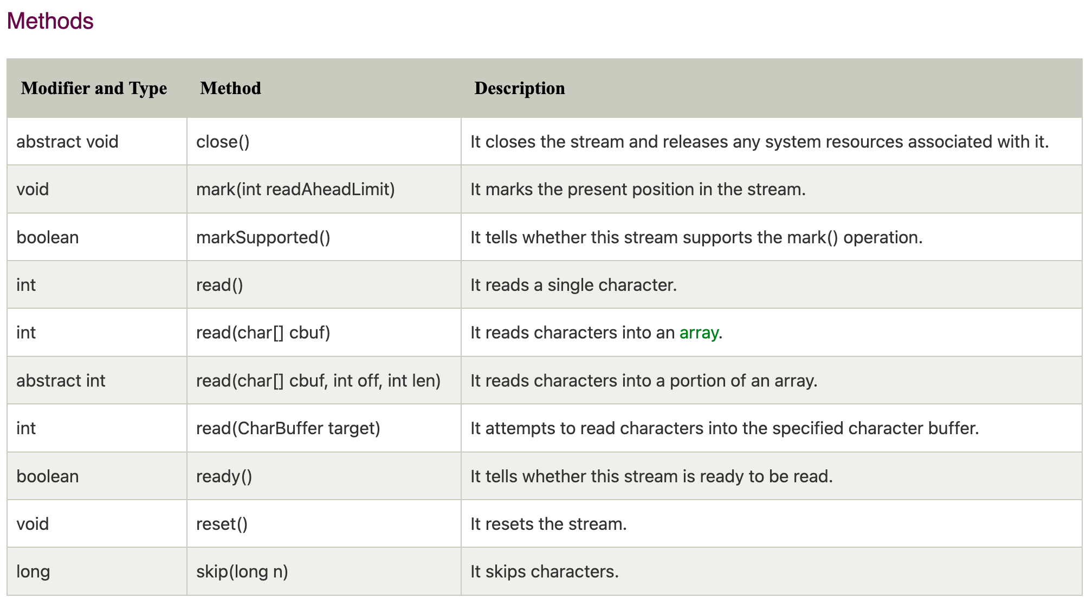
Java Reader

Slide 27
Reader/Writer
Reader reader = new FileReader(source); Writer writer = new FileWriter(destination); int charRead; while ((charRead = reader.read()) > -1) { writer.write(charRead); }

Slide 28
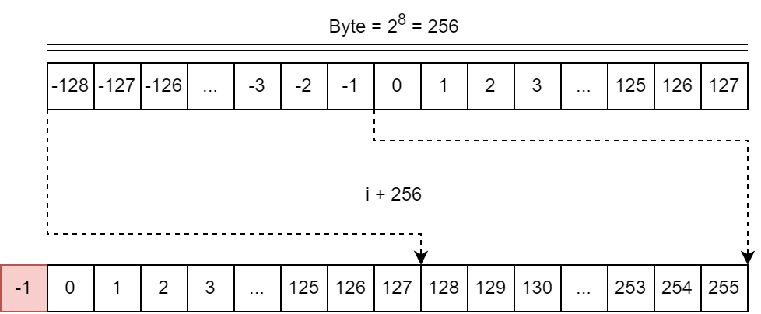

Slide 29
Buffered
Java BufferedWriter class is used to provide buffering for Writer instances. It makes the performance fast. It inherits Writer class. The buffering characters are used for providing the efficient writing of single arrays, characters, and strings
Java BufferedReader class is used to read the text from a character-based input stream. It can be used to read data line by line by readLine() method. It makes the performance fast. It inherits Reader class.
Java BufferedOutputStream class is used for buffering an output stream. It internally uses buffer to store data. It adds more efficiency than to write data directly into a stream. So, it makes the performance fast.
Java BufferedInputStream class is used to read information from stream. It internally uses buffer mechanism to make the performance fast.

Slide 30
Stream types
Name | Level | Description
FileInputStream | Low | Reads file data as bytes
FileOutputStream | Low | Writes file data as bytes
FileReader | Low | Reads file data as characters
FileWriter | Low | Writes file data as characters
BufferedReader | High | Reads character data from an existing Reader in a buffered manner
BufferedWriter | High | Writes character data to an existing Writer in a buffered manner
ObjectInputStream | High | Deserializes primitive Java data types and graphs of Java objects from an existing InputStream
ObjectOutputStream | High | Serializes primitive Java data types and graphs of Java objects to an existing OutputStream
InputStreamReader | High | Reads character data from an existing InputStream
OutputStreamWriter | High | Writes character data to an existing OutputStream
PrintStream | High | Writes formatted representations of Java objects to a binary stream
PrintWriter | High | Writes formatted representations of Java objects to a text-based output stream

Slide 31
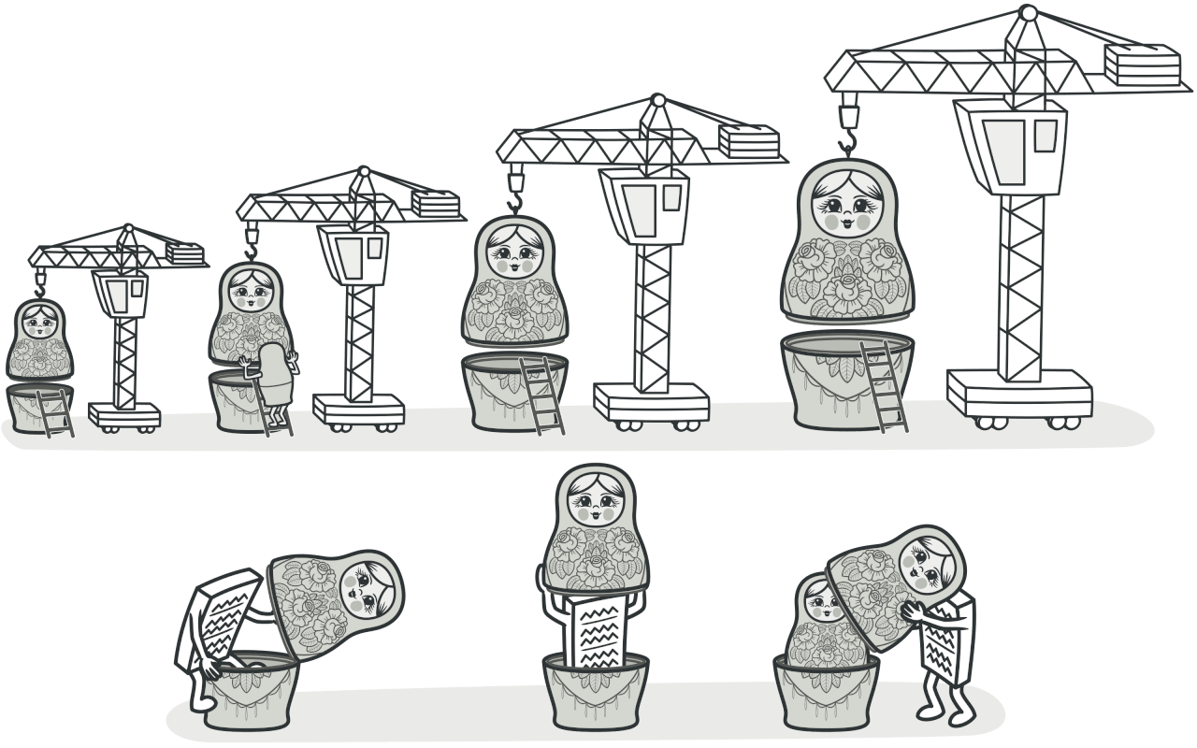
Decorator Design Pattern
https://refactoring.guru/design-patterns/decorator

Slide 32
Decorator Design Pattern
InputStream in = new UpperCaseInputStream(
new BufferedInputStream(
new FileInputStream("test.txt")
)
);

Slide 33
java.io.File
The File class is an abstract representation of file and directory pathname. A pathname can be either absolute or relative.
The File class have several methods for working with directories and files such as creating new directories or files, deleting and renaming directories or files, listing the contents of a directory etc.
Directories and Files
Does not require file existence for instantiation of File class

Slide 34
Useful Methods
exists()
getName()
getParent()
getAbsolutePath()
isDirectory()
isFile()
length()
lastModified()
delete()
renameTo(File)
mkdir()
mkdirs()
listFiles()

Slide 35
IO – java.io
The java.io package was introduced in Java 1.0, with Reader introduced in Java 1.1. It provides:
InputStream and OutputStream – that provide data one byte at a time
Reader and Writer – convenience wrappers for the streams
blocking mode – to wait for a complete message
NIO – java.nio
The java.nio package was introduced in Java 1.4 and updated in Java 1.7 (NIO.2) with enhanced file operations and an ASynchronousSocketChannel. It provides:
Buffer – to read chunks of data at a time
CharsetDecoder – for mapping raw bytes to/from readable characters
Channel – for communicating with the outside world
Selector – to enable multiplexing on a SelectableChannel and provide access to any Channels that are ready for I/O
non-blocking mode – to read whatever is ready

Slide 36
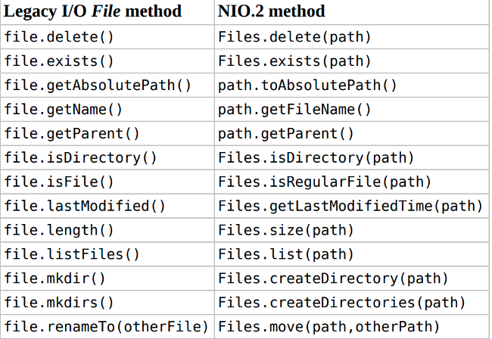
java.io.File vs NIO.2 methods

Slide 37
Paths.get and Path.of
If we're working with a version between Java 7 and 10, we have no other choice but to use Paths.get(). Otherwise, if we're working with a later version, we should go for Path.of(). The Paths class may indeed be deprecated in a future Java release, as it's stated in the class' comments. Moreover, using directly the factory method from Path spares an additional input.
public final class Paths {
public static Path get(URI uri) {
return Path.of(uri);
}
}

Slide 38
absolute path vs relative path
The path with reference to root directory is called absolute. The path with reference to current directory is called relative.
/home/waqas
documents/example.txt
/ -> root
. -> THIS dir path
.. -> go "up" one level

Slide 39
Files and Streams
static Stream<Path> find(Path start,
int maxDepth,
BiPredicate<Path,
BasicFileAttributes> matcher,
FileVisitOption... options)
static Stream<Path> list(Path dir)
static Stream<String> lines(Path path)
static Stream<String> lines(Path path, Charset cs)
static Stream<Path> walk(Path start,
FileVisitOption... options)
static Stream<Path> walk(Path start,
int maxDepth,
FileVisitOption... options)

Slide 40
Files and Streams
An important thing to notice is that the returned streams are LAZY, which means that the elements are not loaded (or read) until they are used. This is a great performance enhancement.

Slide 41
Reading file using Files.readAllLines
readAllLines(Path) method reads all the lines of the file into a list of String. It is not a very efficient way to read a file as a whole file is stored in a list which means consuming more memory.
List<String> strings = Files.readAllLines(path);

Slide 42
Reading file using Files.lines
In Java 8 lines() method has been added in Files class which provides a better way to read files. This method won't read all lines of the file at once but read lines from a file as a Stream line by line.
Stream<String> lines = Files.lines(path);

Slide 43
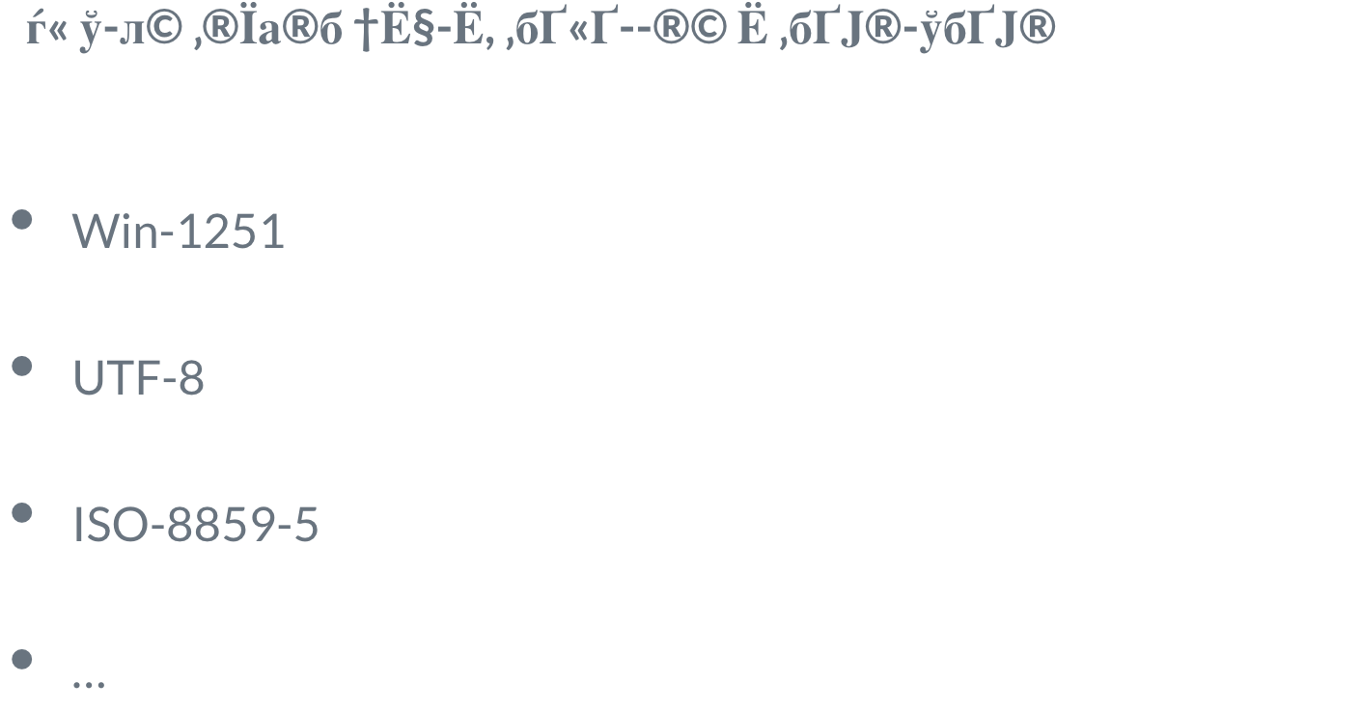
Encoding

Slide 44
Links
https://docs.oracle.com/javase/tutorial/essential/exceptions/tryResourceClose.html
https://ocpj8.javastudyguide.com/ch25.html
https://www.baeldung.com/java-nio-2-file-api
https://www.baeldung.com/java-exceptions
https://www.baeldung.com/java-serialization
https://github.com/VadymMyroshnyk/exception-input-output/tree/main

Slide 45
Q&A

